Slide 1
Analysis of Fire Fighting Methods using Cellular Automaton Modeling
Matthew Wilson, Brent D. Foy
Notes:
Put on physics department and psychology department

Slide 2
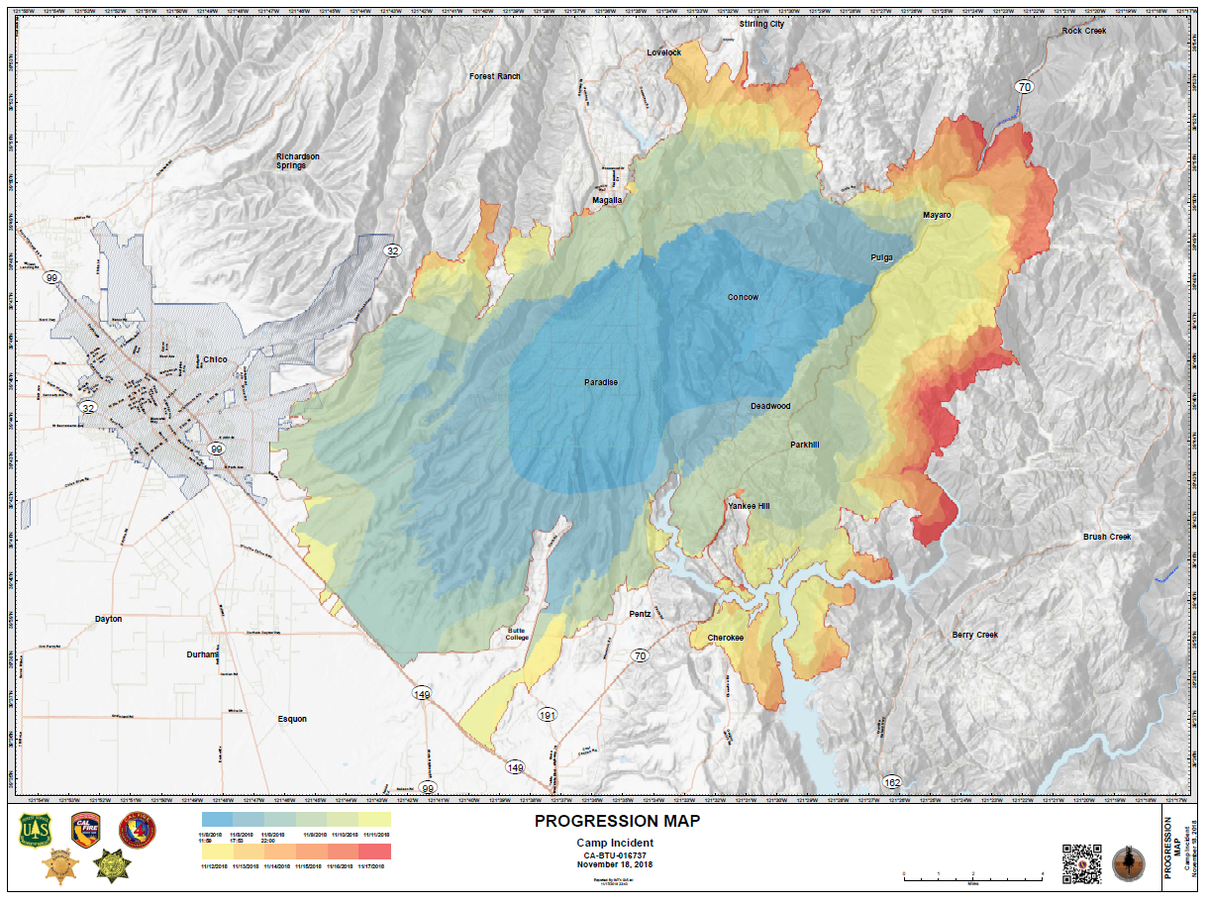
Forest Fires and their Effects
Camp Fire Wildfire
Destroyed over 150,000 Acers
85 Civilian Deaths (2018) [1]

Slide 3
Cellular Automaton

Slide 4
References
[1] Camp Fire Final report (2018)
[2]

